Slide 1
Type 2 Diabetes
A Compartment Model for Evaluation of Glucose, Glucagon, and Insulin Dynamics
Chloe Gonterman, Jake Peters, Rachel Surridge

Slide 2
Project Scope
Model the body’s response to glucose and insulin input from an artificial source
by looking at: blood glucose value and pancreatic insulin output.

Slide 3
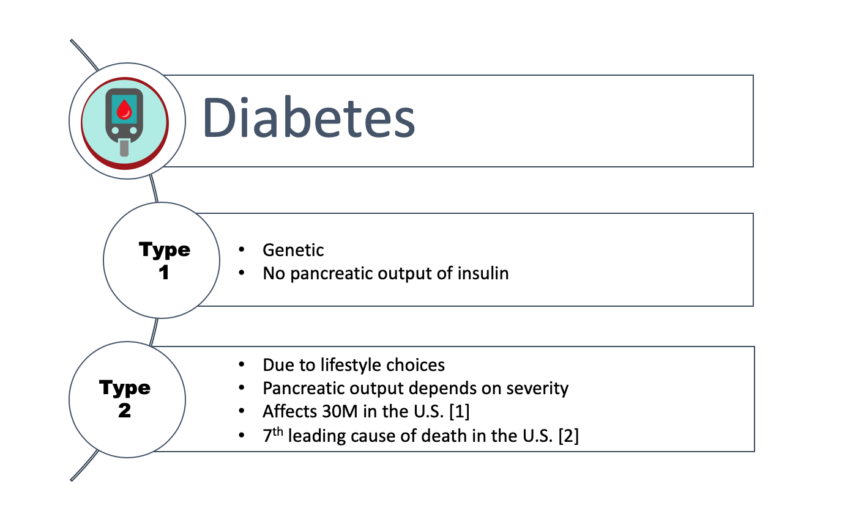
[1] Center for Disease Control and Prevention, “Diabetes and Prediabetes Fast Facts,” U.S. Department of Health and Human Services. 2019.
[2] J. Berry. “Statistics and facts about type 2 diabetes,” Medical News Today, Apr. 2019.

Slide 4
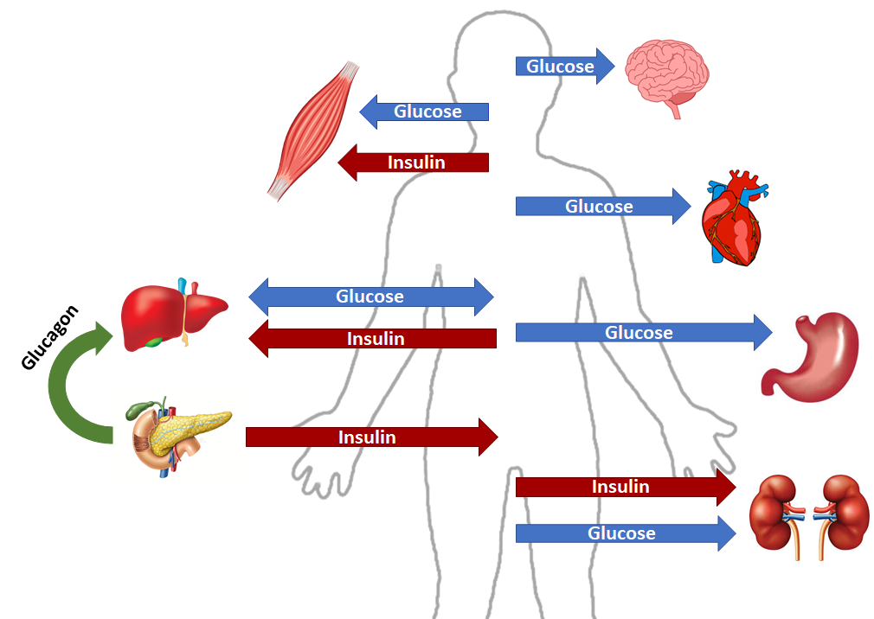
Sorensen’s Compartmental Model
[3] O. Vahidi. “Dynamic modeling of glucose metabolism for the assessment of type II diabetes mellitus,” University of British Columbia. Feb. 2013.

Slide 5
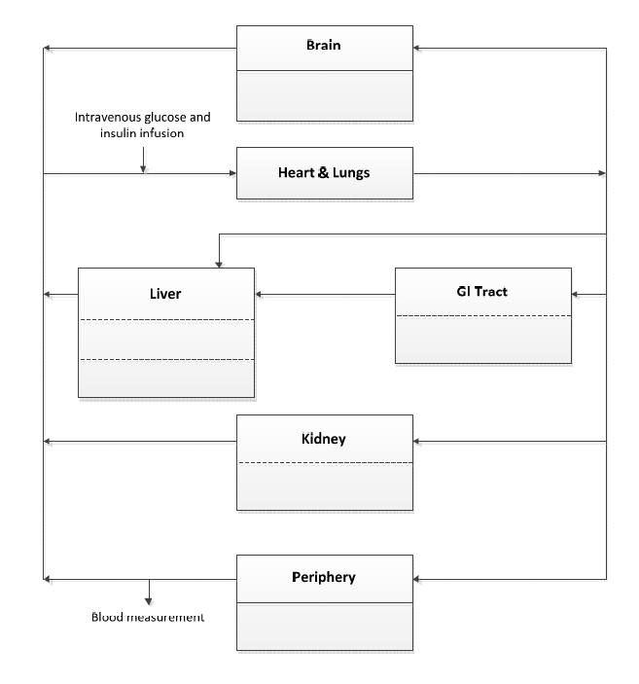


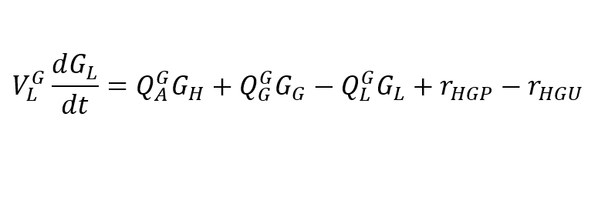


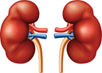

The Glucose Subsystem
Example mass balance equation across liver compartment:
G: glucose concentration (mg/dL)
V: compartment volume (dL)
Q: efflux/outflux (dL/min)
r: production/consumption rate (mg/min)

Slide 6
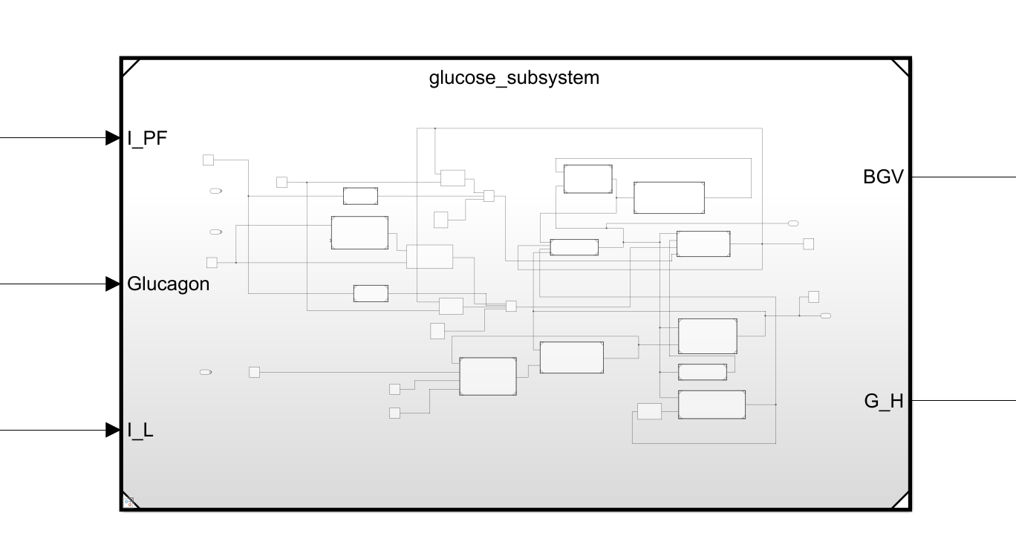
The Glucose Subsystem
Insulin
BGV
Heart Glucose
Glucagon

Slide 7
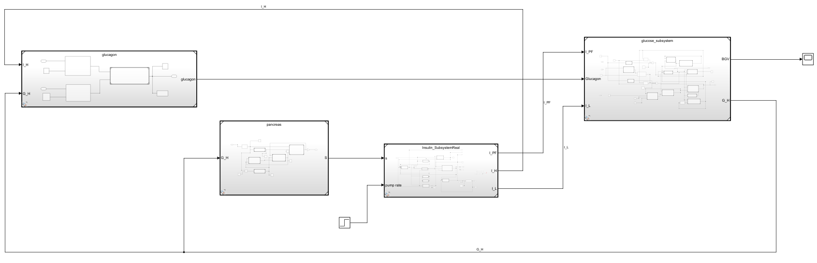
Physiological Plant with 4 Subsystems
Insulin, Heart
Glucose
Glucagon
Insulin, Periph.
Glucagon, Body
BGV
Insulin Release Rate
Pancreas
Insulin
Glucose Infusion
Insulin, Liver
Pump Instructions
Glucose, Heart

Slide 8
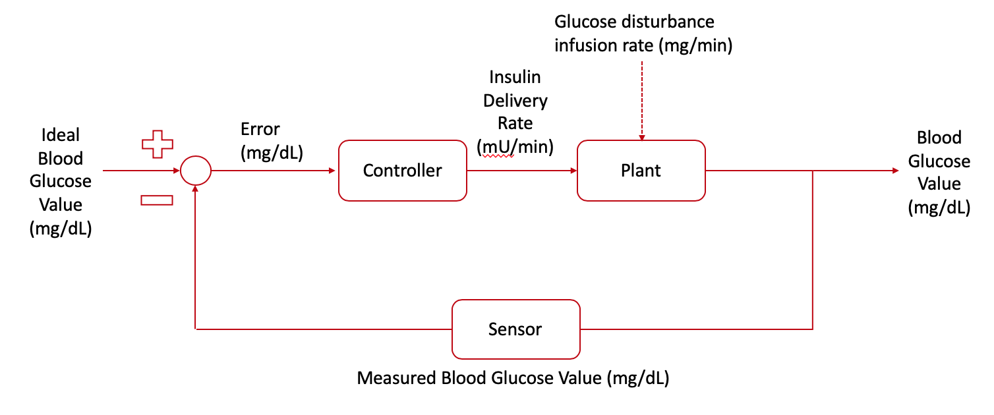
Plant Implemented into Closed Loop System

Slide 9
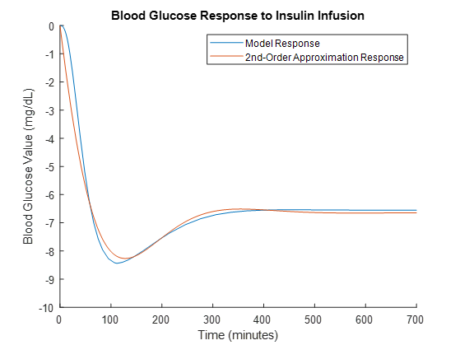

Linearization
A step up in insulin delivery rate causes a step down in BGV
85% fit using MATLAB’s tfest

Slide 10
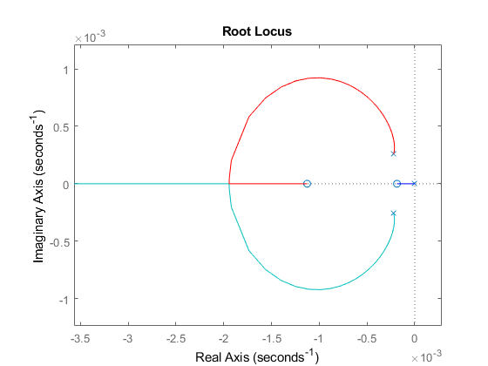
Controller
P: 1
I: 0.001
D: 100
Additional Conditions:
0-12 U/min saturation [4]
No pump output allowed when BG is lower than target
[4] G. Freckmann, et al. “Accuracy of bolus and basal rate delivery of different insulin pump systems,” Diabetic Technology and Therapeutics, 2019. 24(4): 201-208.

Slide 11
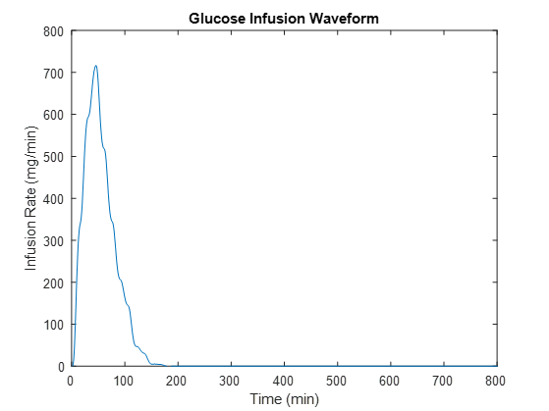
System Response to Glucose Infusion
Target glucose: 120 mg/dL
Disturbance: 44g over 120 min

Slide 12
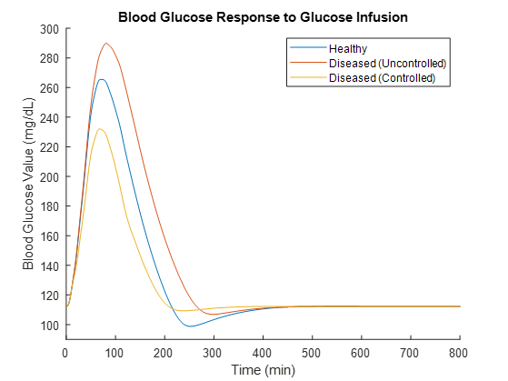
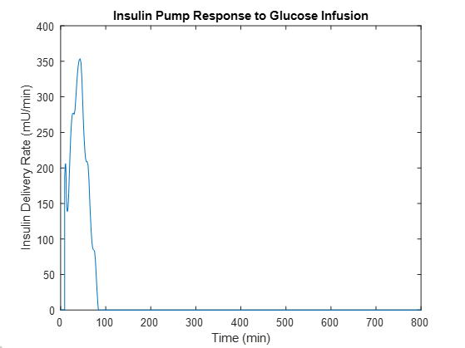
System Response to Glucose Infusion

Slide 13
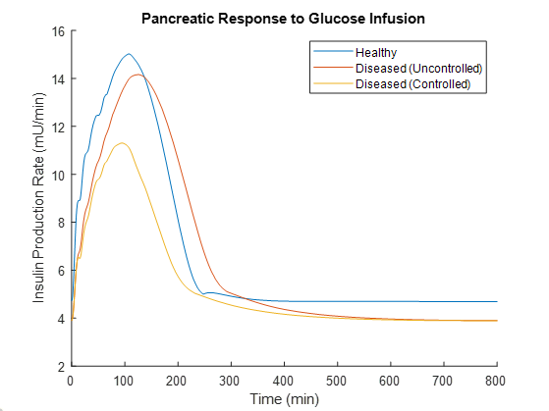
Pancreatic Output

Slide 14

Thank you!
Questions?

Slide 15
Limitations, Simplifications, & Expansions
Model Assumptions [5]
Body compartments
Assume instantaneous mixing
Hormonal effects are neglected
Amino Acids and fatty acids not considered
Physiological parameters to represent at 70kg adult male
5L of blood in the system
Body compartment sizes
Group Assumptions [6]
Insulin pump mixing
Insulin is delivered intravenously, not subcutaneously
Assume instantaneous mixing
[5] O. Vahidi. “Dynamic modeling of glucose metabolism for the assessment of type II diabetes mellitus,” University of British Columbia. Feb. 2013.
[6]J. D. Enderle, “Compartmental Modeling,” Introduction to Biomedical Engineering (Third Edition), 27-Jul-2012.

Slide 16
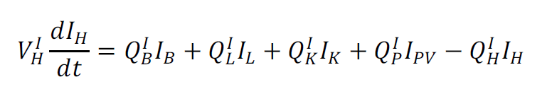
Artificial Insulin Pump Integration
Production rate in the heart compartment of insulin submodel mimics intravenous injection
+ r_{IIR}
IIR = insulin infusion rate (mU/min)

Slide 17

Glucose Disturbance
Production rate in the heart compartment of glucose submodel mimics intravenous injection
+ r_{GIR}
GIR = glucose infusion rate (mg/min)

Slide 18
Healthy vs. T2 Diabetic
Parameter values within the model are altered to reflect:
Decreased peripheral sensitivity to both insulin and glucose
Decreased hepatic sensitivity to both insulin and glucose
Decreased rate of pancreatic insulin secretion
New parameter values were calculated by doing a best-fit to clinical data from type II diabetic patients subjected to an intravenous glucose tolerance test [x].

Slide 19
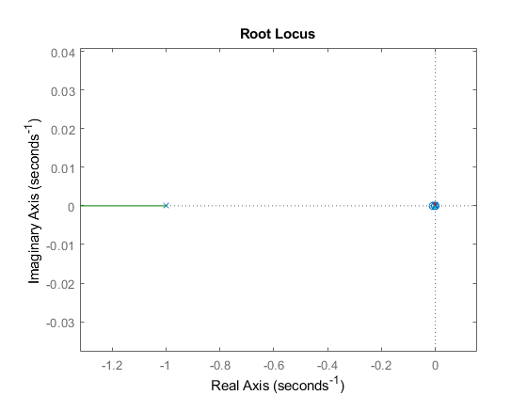
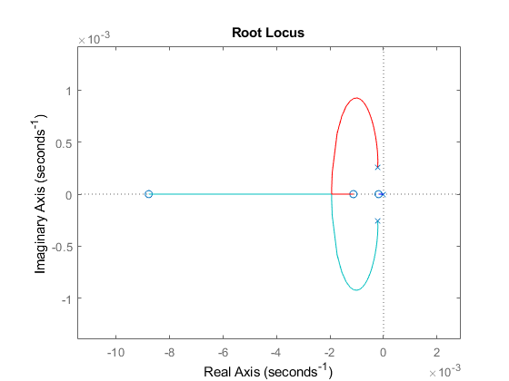
Expanded Root-Locus

